Slide 1

An app brought to you by Group 4
Annie, Lizzie, Lowena, Luciana, Maebh, Saamiya

Slide 2
So what is Films For You
What is it?
Films For You is a web app that serves to provide users with film options for movie night!
What does it need to work?
The web app relies on the Flask API network, packages WTForms, requests (SQL), mysql-connector, and mysql-connector-python for the front-end.

Slide 3
How does it work
In order to generate a film recommendation, users need to provide the following inputs:
Genre(s) of interest
Restrictions on age ratings
Length of film
Users can also input keywords to search for films with themes, e.g. magic, could help return Harry Potter.

Slide 4
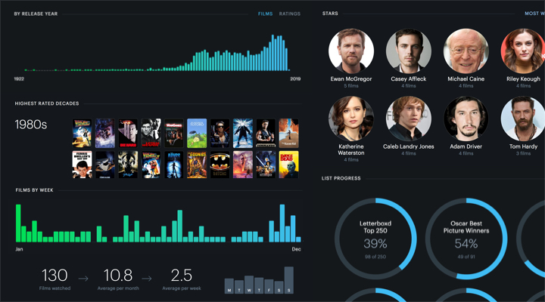
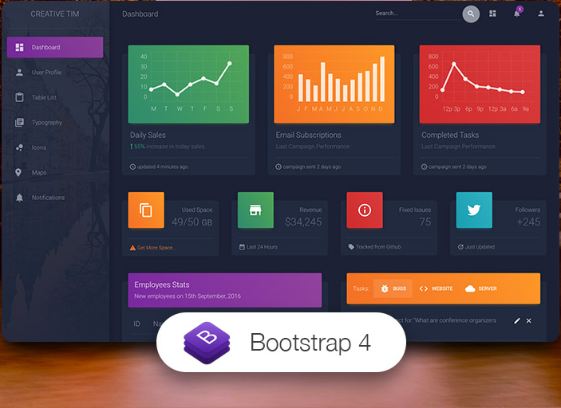
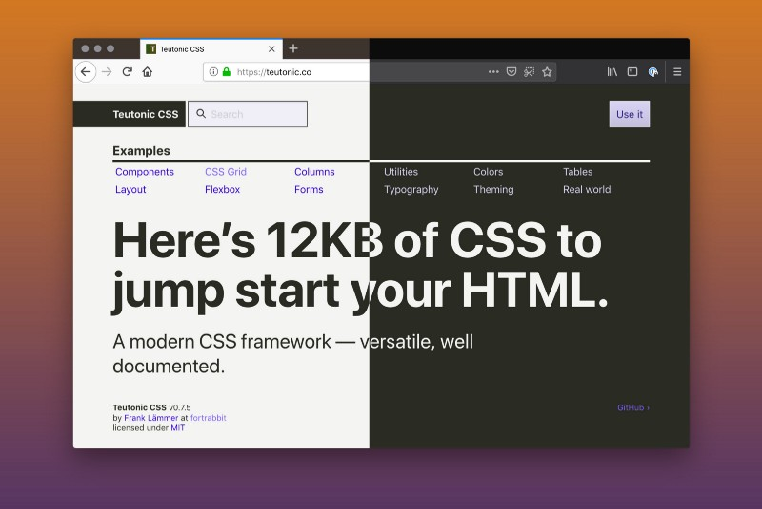
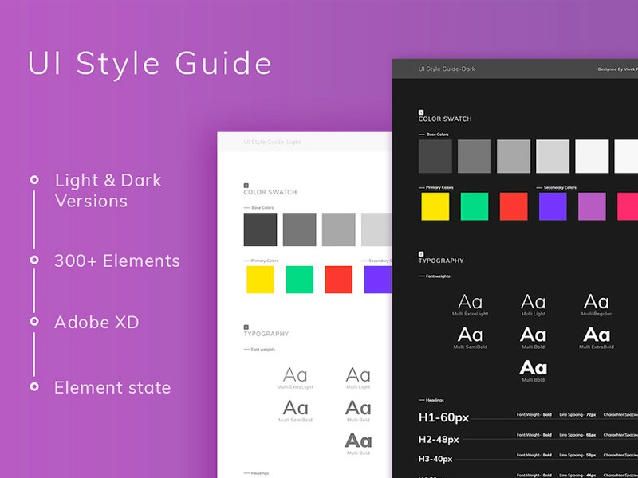

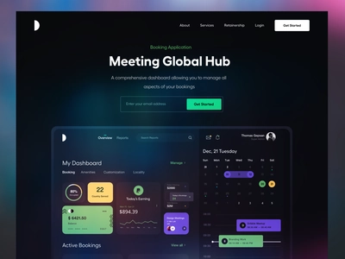
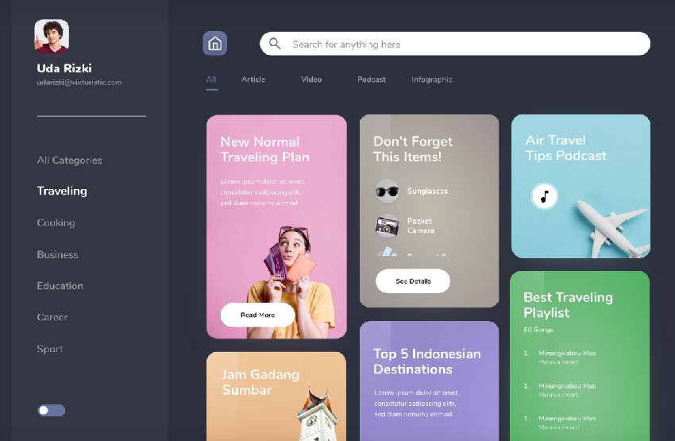
Brand book
Design concepts that informed the look and feel

Slide 5







Streaming
Our app puts the user’s requirements at the centre of their experience
Generic recommendation
Personalised
Recommendation alone

Slide 6
What’s next for the app?
Future iterations of the app aim to have the following features:
Links to the trailer
Links to where the user can watch the film
Watchlist curation with shared collaboration for watchlists
Social features e.g. collaboration with friends

